Slide 1
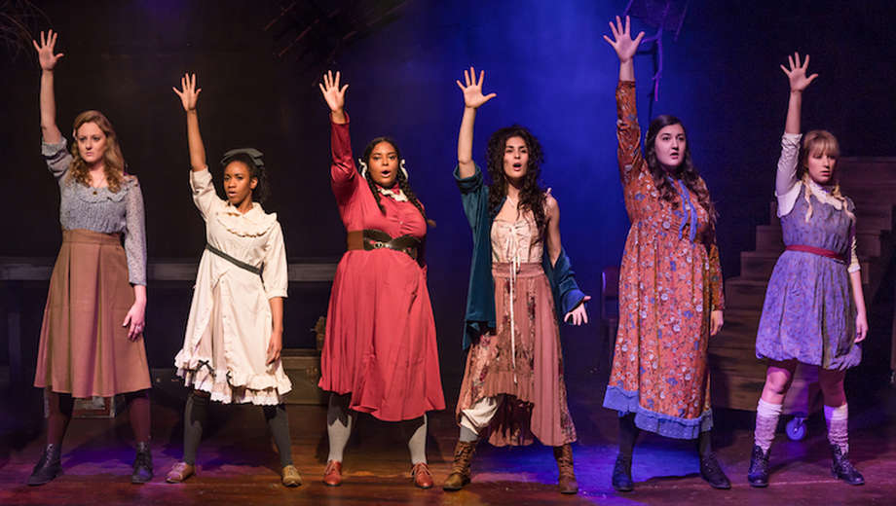
Values and Aspirations
Frank Wedekind Frühlings Erwachen

Slide 2
Context
Societies ineptitude in dealing with sexual matters.
Nature vs. Civilization.
‘Sollen’ and ‘Wollen’ equation.
References to ‘Lebensphilosophie’ with Nietzsche and Freud.
Faust and Religion.

Slide 3
5. What different things are shown to shape adolescents and their lives, values and aspirations?
Education and intellectual curiosity- Schooling comes across didactic, both in school and at home.
Repression of intellectual curiosity shown in Melchior’s ‘trial’.
Natural desires and growing up/ puberty- relates to Freud in their conversation regarding their dreams.
Religion- Melchior, Faust and the disenchantment of the world (Entzauberung).

Slide 4
6. How does the play depict a conflict between “natural” desire and bourgeois morality?
The ‘Sollen/ Wollen’ Equation- ‘Wollen may be understood as the broad range of self-assertive and sexual impulses, while Sollen represents the whole complex of social, ideological, and religious sanctions, perceived and enforced as absolute imperatives.’
In response to Melchior's question, "Was denken Sie über Moral?", the masked stranger remarks, "Unter Moral verstehe ich das reele Produkt zweier imaginärer Größen. Die imaginären Größen sind Sollen und Wollen. Das Produkt heißt Moral und läßt sich in seiner Realität nicht leugnen."
People turn to pen and paper when repressed from freedom of speech, e.g. Melchior’s essay to Moritz about sex and Melchior’s letter to Wendla.
‘Fortpflanzung’- Understanding of sexuality through observation of plants/ animals. Melchior has learnt most of his practical knowledge of sex by watching animals. Korrektionsanstalt (punishment) – confining dangerous pubescent children to prison as dangerous animals are wished to be put behind bars.

Slide 5
7. Has education failed young people here or have they failed education?
Melchior’s father- endorses harsh discipline and punishment
Frau Gabor- empathetic and kind woman who does not agree with sending her son to the reparatory school until she finds out he raped Wendla. Does not find her son reading Faust as appropriate before adulthood.
Melchior- condemns Moritz’s feminist views, does not agree that discussing sex should be frowned upon
Mrs Bergmann and Wendla: when Wendla wants to hear more about sex and how reproduction works, her mother panics and is reluctant to speak about it, saying it should only happen when two people are married and in love.

